Slide 1
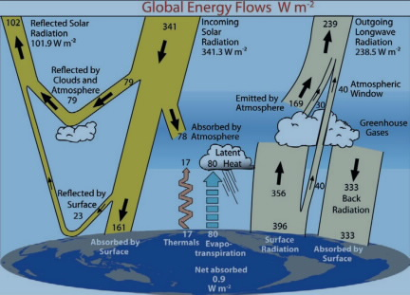
Principle of Energy balance
Basic idea: In steady state, the total Energy coming In to the earth equals the total Energy going Out
Total Energy In = Total Energy Out
This is called the Principle of Energy Balance, and we can use it as a basis of modeling climate (Lab).
See www.cgd.ucar.edu/cas/abstracts/files/kevin1997_1.html

Slide 2
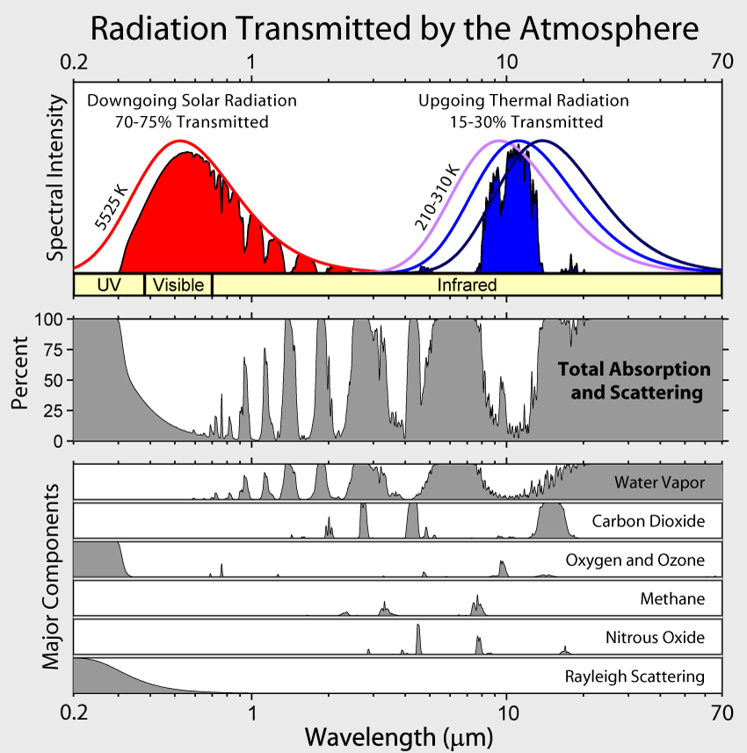
Incoming: shortwave from the sun, longwave (back radiation) from the atmosphere
Shortwave
3
Of the shortwave coming down from the sun, about 30% gets reflected by clouds and the surface (ice/snow).

Slide 3
Incoming: shortwave from the sun, longwave (back radiation) from the atmosphere
Shortwave
3
The longwave coming down from the atmosphere is actually greater than the shortwave!

Slide 4
Outgoing: longwave surface radiation, thermals, and evapotranspiration
Longwave
3
The longwave light energy coming off the surface is also pretty big!
The outgoing longwave is actually adjustable: it glows more when it’s hotter. You can’t see that in this figure because the heights have been rescaled, but …

Slide 5
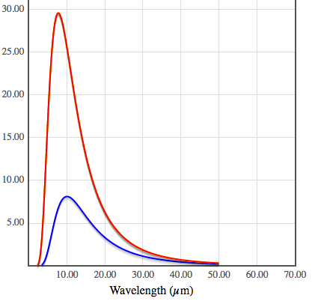
Outgoing: longwave surface radiation, thermals, and evapotranspiration
Longwave
... these graphs with actual values on the y-axis show that the area under the red curve (hotter Earth) is bigger than the area under the blue curve (colder Earth).
The idea that hot objects glow more is the idea behind the Stefan-Boltzmann Law, which we’ll return to later this week.

Slide 6
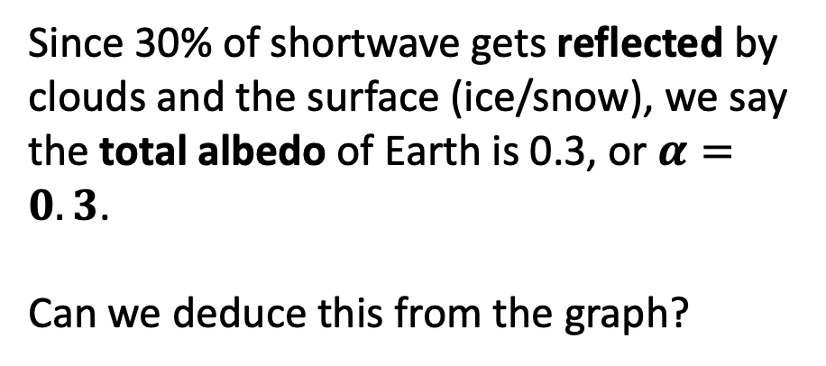
Focus on the shortwave: the albedo
Shortwave
3
Since 30% of shortwave gets reflected by clouds and the surface (ice/snow), we say the total albedo of Earth is 0.3, or $α=0.3$.
Can we deduce this from the graph?

Slide 7
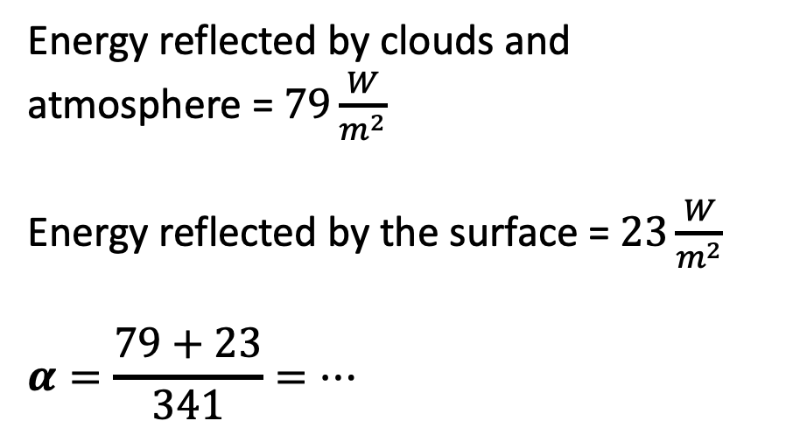
Focus on the shortwave: the albedo
Shortwave
3
Energy reflected by clouds and atmosphere = $79\frac{W}{m^{2}}$
Energy reflected by the surface = $23\frac{W}{m^{2}}$
$$α=\frac{79+23}{341}=…$$

Slide 8
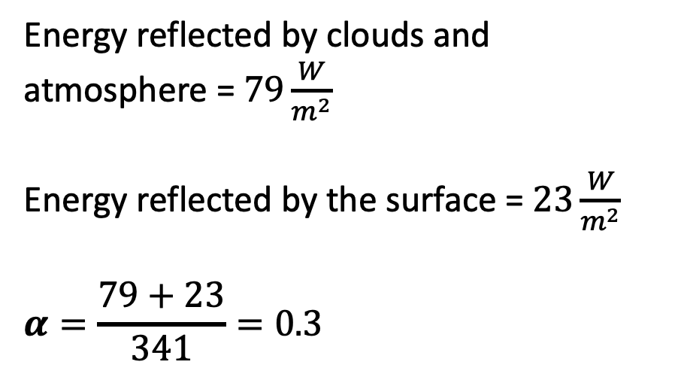
Focus on the shortwave: the albedo
Shortwave
3
Energy reflected by clouds and atmosphere = $79\frac{W}{m^{2}}$
Energy reflected by the surface = $23\frac{W}{m^{2}}$
$$α=\frac{79+23}{341}=0.3$$

Slide 9
Focus on the shortwave: the albedo
Shortwave
3
This means 30% of shortwave energy from the sun gets reflected by clouds and the surface before it has a chance to deliver energy to the climate system.

Slide 10
Focus on the shortwave: the albedo
Shortwave
Obviously (from these numbers), the most important contributor to the albedo are clouds and the atmosphere. But is the earth’s surface albedo a significant player in climate?
To answer, we need to compare to other anthropogenic forcing values …

Slide 11
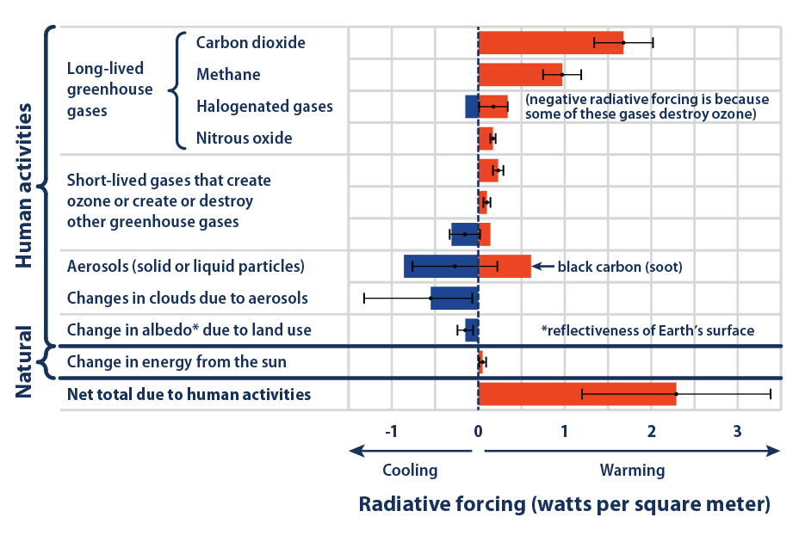

Breakdown of the anthropogenic radiative forcing so far
Anthropogenic forcing that has caused the 1.2 ºC warming so far is $2.6\frac{W}{m^{2}}$
=> Yeah, that $23\frac{W}{m^{2}}$ due to surface albedo is pretty important!

Slide 12
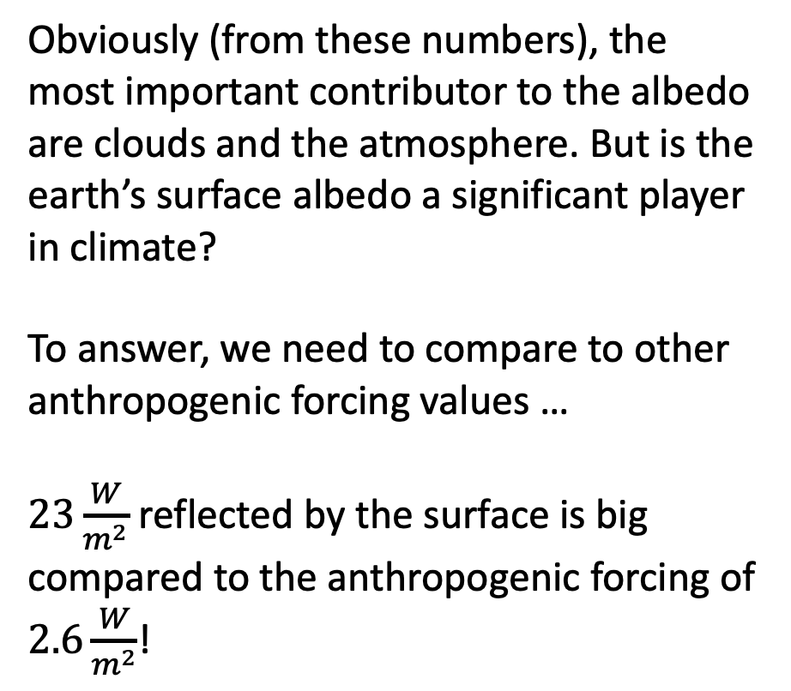
Focus on the shortwave: the albedo
Shortwave
Obviously (from these numbers), the most important contributor to the albedo are clouds and the atmosphere. But is the earth’s surface albedo a significant player in climate?
To answer, we need to compare to other anthropogenic forcing values …
$23\frac{W}{m^{2}}$ reflected by the surface is big compared to the anthropogenic forcing of $2.6\frac{W}{m^{2}}$!

Slide 13
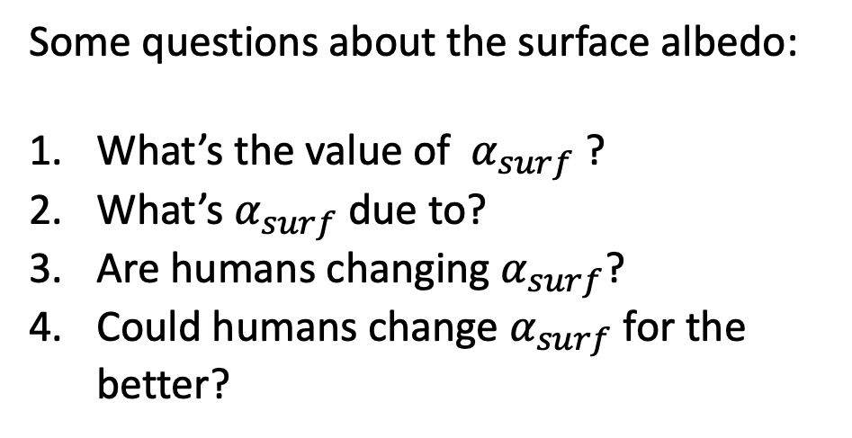
Focus on the shortwave: the albedo
Shortwave
Some questions about the surface albedo:
What’s the value of $α_{surf}$ ?
What’s $α_{surf}$ due to?
Are humans changing $α_{surf}$?
Could humans change $α_{surf}$ for the better?

Slide 14
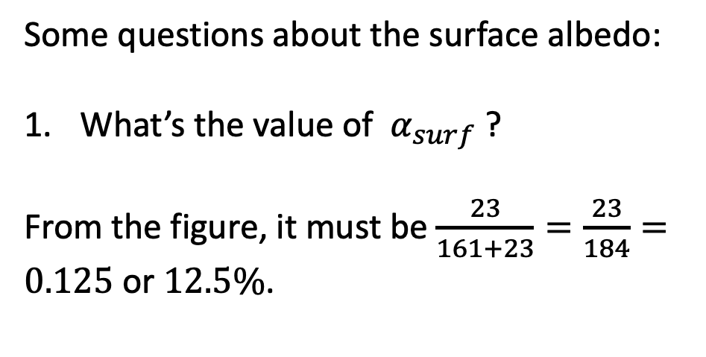
Focus on the shortwave: the albedo
Shortwave
Some questions about the surface albedo:
What’s the value of $α_{surf}$ ?
From the figure, it must be $\frac{23}{161+23}=\frac{23}{184}=0.125$ or $12.5\%$.
184

Slide 15
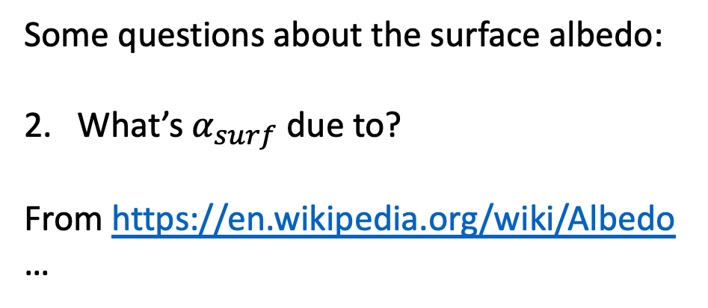
Focus on the shortwave: the albedo
Shortwave
Some questions about the surface albedo:
2. What’s $α_{surf}$ due to?
From https://en.wikipedia.org/wiki/Albedo …
184

Slide 16
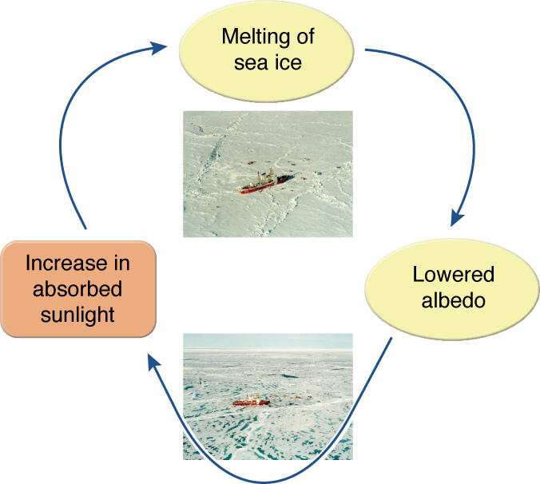
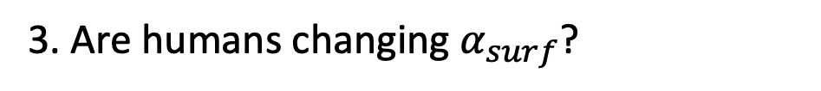
Focus on the shortwave: the albedo
Shortwave
3. Are humans changing $α_{surf}$?
Ice-albedo feedback

Slide 17
Focus on the shortwave: the albedo
3. Are humans changing $α_{surf}$?
Changing forests to savannas, deserts (see https://en.wikipedia.org/wiki/Albedo again … aerosols … black carbon on snow …

Slide 18
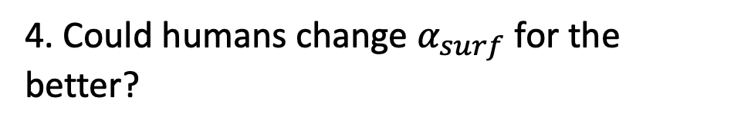
Focus on the shortwave: the albedo
4. Could humans change $α_{surf}$ for the better?
Less fossil fuel burning => less black carbon on snow (good) … Inject aerosols into the stratosphere (good-bye to seeing stars at night) … Paint things white … reverse ice-albedo feedback

Slide 19
Focus on the shortwave: the albedo
Shortwave
3. Are humans changing $α_{surf}$?
Reverse ice-albedo feedback

Slide 20
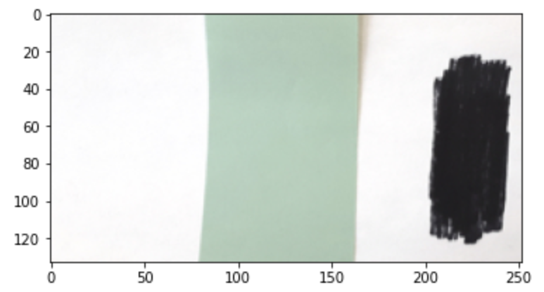
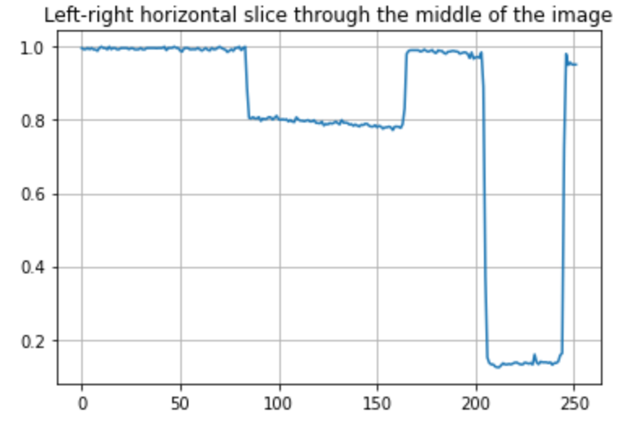

Measuring the albedo of a hypothetical land surface
$$α≈ …$$
Brightness (arbitrary units)

Slide 21
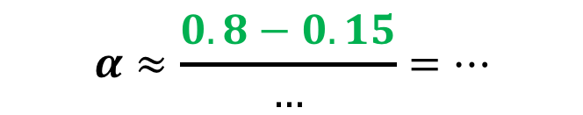
Measuring the albedo of a hypothetical land surface
$$α≈\frac{0.8−0.15}{…}=…$$
Brightness (arbitrary units)

Slide 22
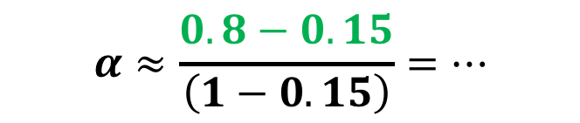
Measuring the albedo of a hypothetical land surface
$$α≈\frac{0.8−0.15}{\left(1−0.15\right)}=…$$
Brightness (arbitrary units)

Slide 23
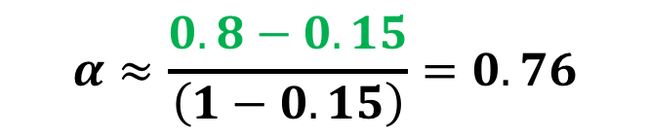
Measuring the albedo of a hypothetical land surface
$$α≈\frac{0.8−0.15}{\left(1−0.15\right)}=0.76$$
=> The albedo of the green surface is 0.76
Brightness (arbitrary units)

